Slide 1

Birla Vishvakarma Mahavidyalaya Engineering College
Academic Year: 2019-2020
Computer Department
CP446:Full Semester External Project
Dental Age detection and Disease detection
Student Details:
Shailly Rajput(16CP021)
Internal Guides:
Prof. Bhavesh Tannawala
Prof. Mahashweta Joshi
External Guides:
Mr. Chirag Patel

Slide 2
Functionalities
Panoramic dental X-ray image
Predict the age
Detect presence of disease

Slide 3
Team Members:
Total Number of members: 2
Work distribution
Age Prediction
Shailly
Disease Detection
Nirzari

Slide 4
Dental Age Detection
Original Image
Teeth Extraction
Input Dataframe Generation
Age Prediction:
17 years 5 months
Enhancement

Slide 5
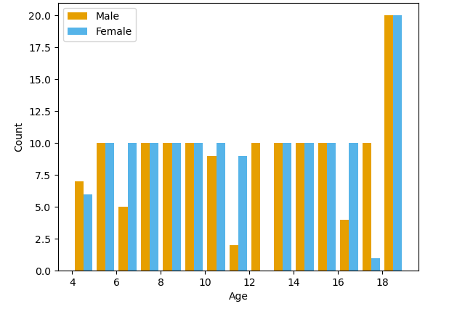
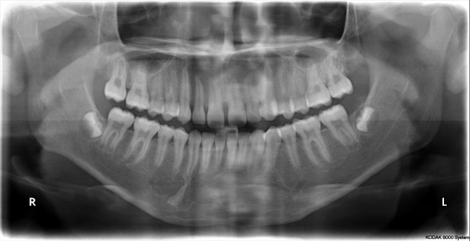
Dataset
Type of X-rays : Panoramic
Total Images: 273
Age Group : 4 – 19
Sample data: Male, 13

Slide 6
Enhancement
Teeth Extraction
Input DataFrame Generation
Age Prediction
Original Image
Histogram Equalization (CLAHE)
K- Means Clustering
Median Filtering

Slide 7
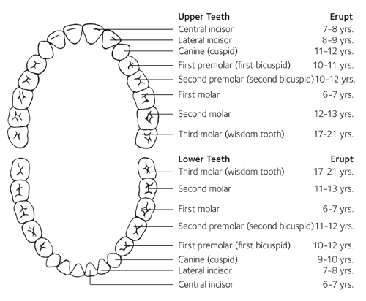
Teeth Extraction
Enhancement
Input DataFrame Generation
Age Prediction
Based on Demirijian’s 8 – teeth method (uses lower left 8 mandibular teeth)
Teeth extracted from the image:
Central Incisor
Lateral Incisor
Canine
First Premolar
Second Premolar
First Molar
Second Molar
Third Molar

Slide 8
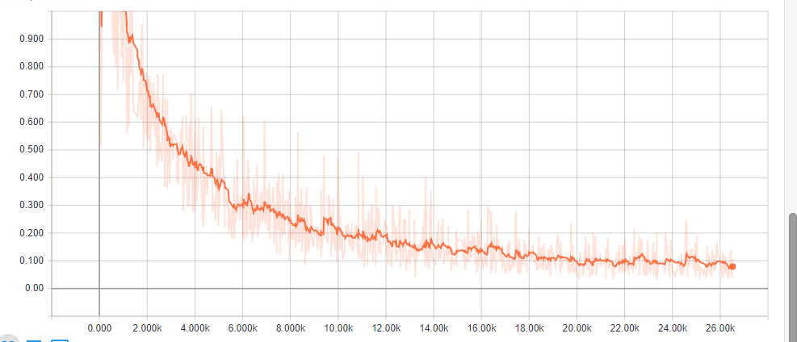
Teeth Extraction
Enhancement
Input DataFrame Generation
Age Prediction
Uses Tensorflow’s Object Detection API
Transfer Learning on Faster RCNN with 8 output classes (8 teeth)
Trained for 29934 epochs on CPU
Loss : 0.03

Slide 9
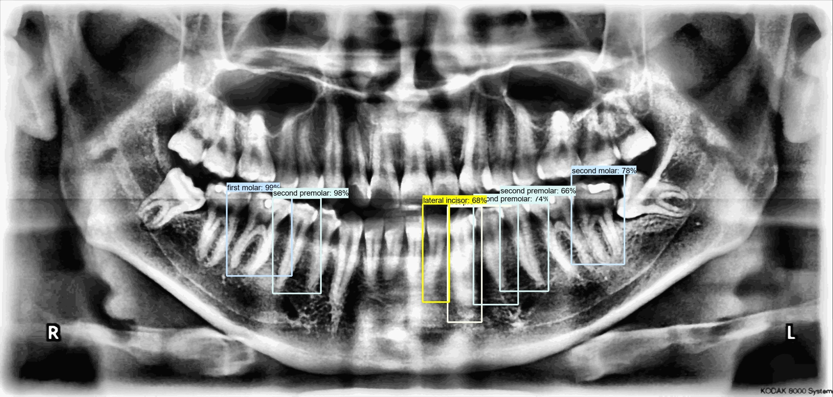
Teeth Extraction
Enhancement
Input DataFrame Generation
Age Prediction

Slide 10
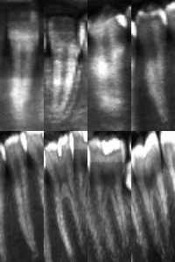
Input DataFrame Generation
Enhancement
Teeth Extraction
Age Prediction

Slide 11
Age Prediction
Enhancement
Teeth Extraction
Input DataFrame Generation
Input Dataframe
Determine Age Group
(Group 0 : age 4 -14)
(Group 1 : age 15 -19)
Predict Age

Slide 12
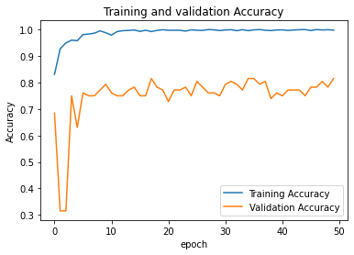
Age Prediction
Enhancement
Teeth Extraction
Input DataFrame Generation
Gender Group Detection
Binary Classification Model
(Group 0 : age 4 -14)
(Group 1 : age 15 -19)
Transfer Learning on ResNet50 with dropout and regularization
Accuracy : 81.52%

Slide 13
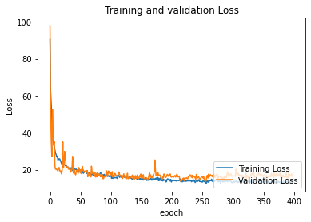
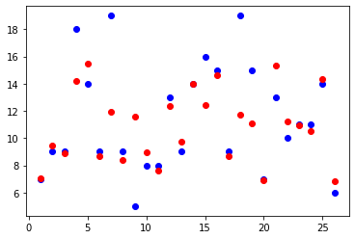
Age Prediction
Enhancement
Teeth Extraction
Input DataFrame Generation
Age Prediction
Model 1 (For group 0):
CNN with Regression
Final layer activation function : Linear
Mean Absolute Error : 1.6977

Slide 14
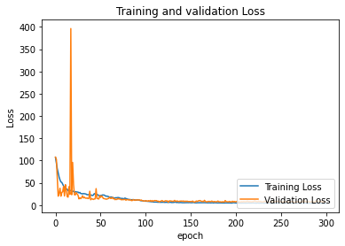
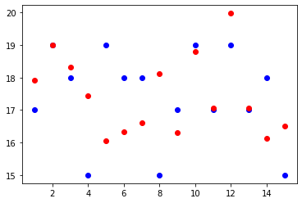
Age Prediction
Enhancement
Teeth Extraction
Input DataFrame Generation
Age Prediction
Model 2 (For group 1):
CNN with Regression
Final layer activation function : Linear
Mean Absolute Error : 1.213

Slide 15
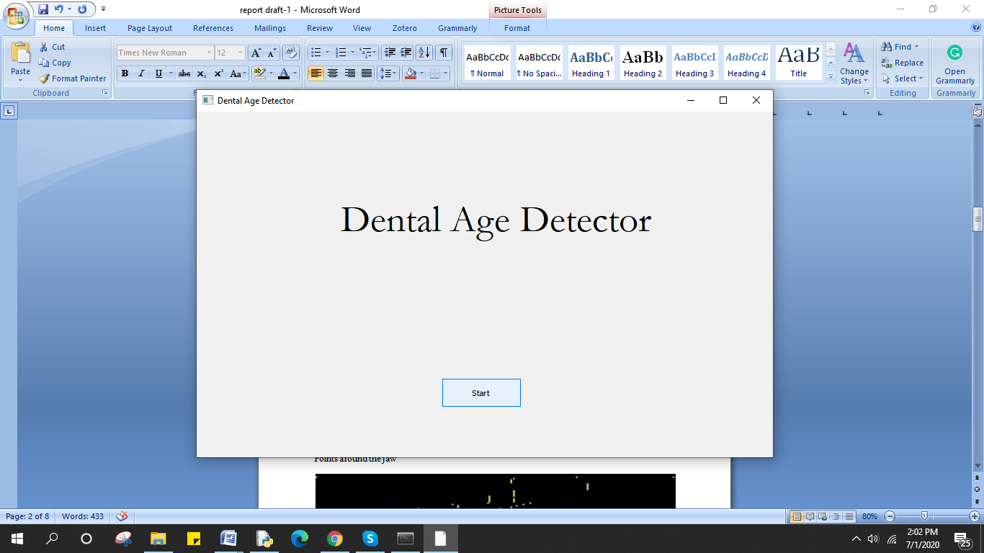
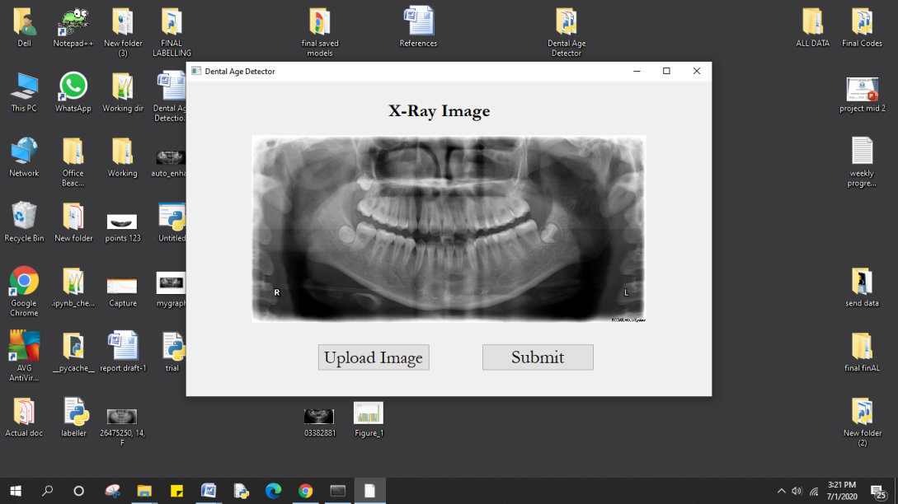
GUI
Developed in PyQt5

Slide 16
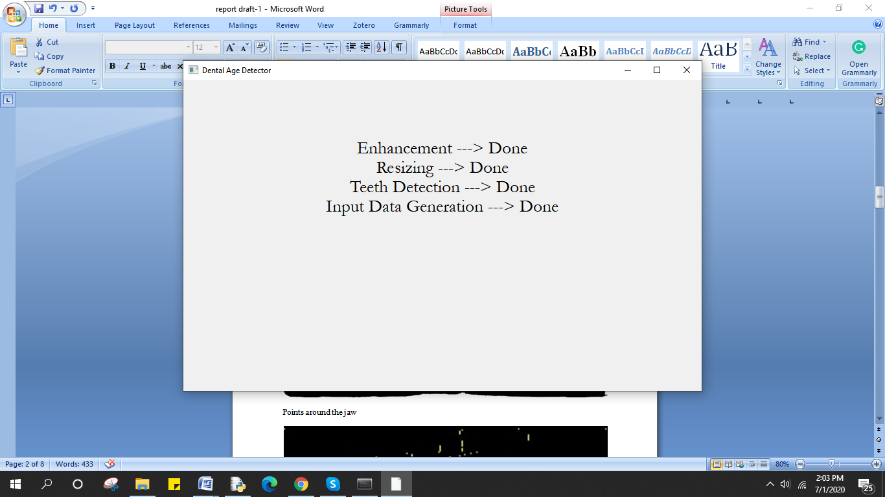
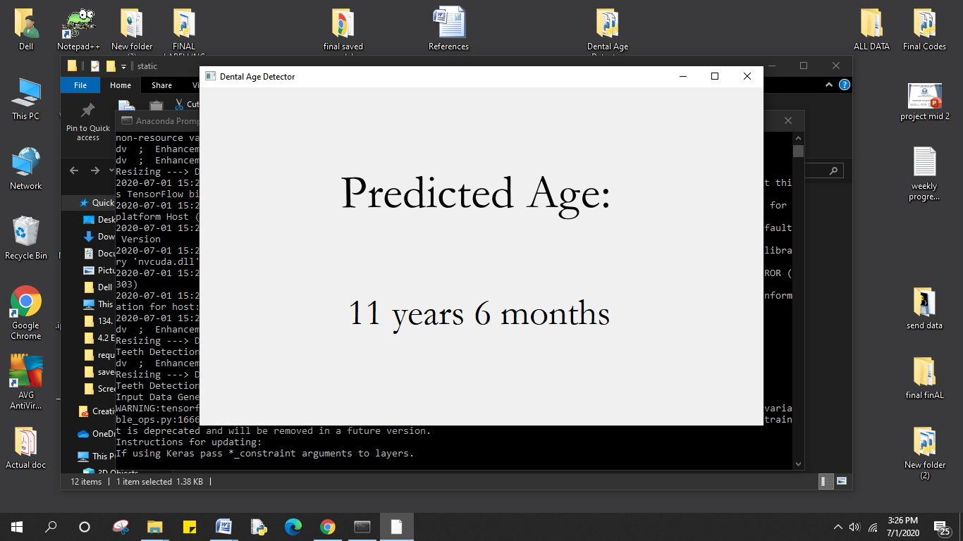
GUI

Slide 17
References
Patel, Omprakash & Maravi, Yogendra & Sharma, Sanjeev. (2013). A Comparative Study of Histogram Equalization Based Image Enhancement Techniques for Brightness Preservation and Contrast Enhancement. Signal & Image Processing : An International Journal. 4. 10.5121/sipij.2013.4502.
Ren, S., He, K., Girshick, R. and Sun, J., 2017. Faster R-CNN: Towards Real-Time Object Detection with Region Proposal Networks. IEEE Transactions on Pattern Analysis and Machine Intelligence, 39(6), pp.1137-1149.
Chaudhary Roshan K, Doggalli Nagabhushana “Commonly used different dental age estimation methods in children and adolescents” International Journal of Forensic Odontology Year : 2018 | Volume: 3 | Issue Number: 2
Roberts, G., Parekh, S., Petrie, A. et al. Dental age assessment (DAA): a simple method for children and emerging adults. Br Dent J 204, E7 (2008).

Slide 18
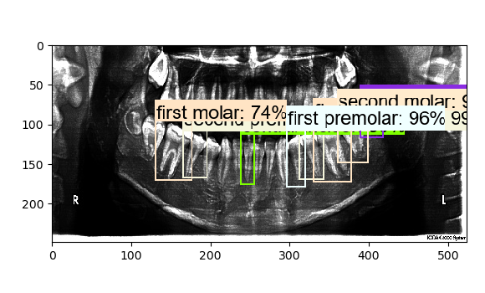
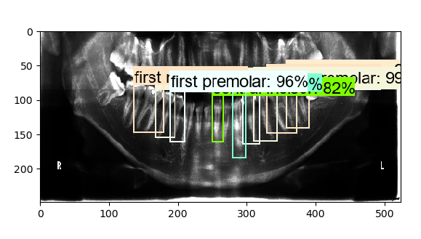
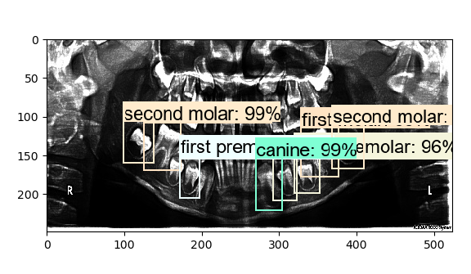
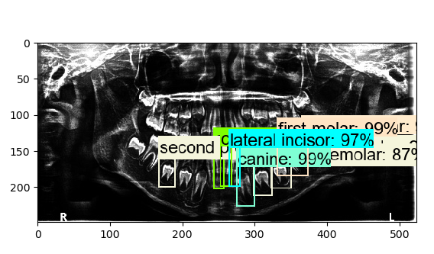
Result of object detection model

Slide 19
Thank you.

